Slide 1
Agile Development Methodology

Slide 2
Agile
Agile is a way to manage projects.
Agile breaks down larger projects into small, manageable chunks called iterations.
At the end of each iteration (which generally takes place over a consistent time interval) something of value is produced.
The product produced during each iteration should be able to be put into the world to gain feedback from users or stakeholders.

Slide 3
Agile
Agile realizes that software projects are inherently unpredictable.
Over the course of any project there are likely to be changes.
Agile embraces this unpredictability. By breaking down projects into small chunks, it makes it easy to prioritize and add or drop features mid project.
Something that is impossible in traditional waterfall projects.

Slide 4
Principles of Agile development
Our highest priority is to satisfy the customer through early and continuous delivery of valuable software.
Deliver working software frequently, from a couple of week to a couple of months, with a preference to the shorter timescale.
Welcome changing requirements, even late in development. Agile’s processes harness change for the customer’s competitive advantage.

Slide 5
Principles of Agile development
Business people and developers must work together daily throughout the project.
Build projects around motivated individuals. Give them the environment and support they need, and trust them to get the job done.
The most efficient and effective method of conveying information to and within a development team is face-to-face conversation.
Working software is the primary measure of progress.

Slide 6
Principles of Agile development
Agile processes promote sustainable development. The sponsors, developers, and users should be able to maintain a constant pace indefinitely.
Continuous attention to technical excellence and good design enhances agility.
Simplicity — the art of maximizing the amount of work not done — is essential.
The best architectures, requirements, and designs emerge from self-organizing teams.

Slide 7
Principles of Agile development
At regular intervals, the team reflects on how to become more effective, then tunes and adjusts its behaviour accordingly.

Slide 8
Why agile is good
Speed to market agile lets you get your concept to your users as quickly as possible.
Flexibility agile is based on accommodating change. Software projects consistently change. As a product comes to life or the market expands, you should be able to react and update the product accordingly.
Risk management incremental releases means that the product can be used early in the process by stakeholders and users. This lets you identify issues and feature deficits early in the process

Slide 9
Why agile is good
Cost control unlike a fixed budget project, agile is flexible with regard to scope. More often than not, our clients realize features they originally requested are no longer necessary. Agile isn’t about paying a lot with uncertainty
Quality agile integrates testing throughout the process. Consistently delivering tested software means higher overall quality and less time spent on quality analysing the full application.

Slide 10
Why agile is good
Right product Incremental releases let you test your product early and often. Even if you don’t release it to the public, it’s much easier to locate flaws and things that can be improved when you have an actual product to play with vs a series of designs
Transparency Agile lets you see, feel and use a project consistently throughout the project. You don’t see things in compartmentalized silos; you see how things work together.

Slide 11
Agile Lifecycle
There are many different flavors of agile. Ultimately, it is up to your team to come up with the best process for you.
Generally they all follow a short life cycle, which repeats during each iteration.
This lecture focuses on Scrum, but many of the features are universal.
Scrum projects are broken down into short iterations (generally 1 – 3 weeks) called sprints.
The lifecycle of each sprint includes:

Slide 12
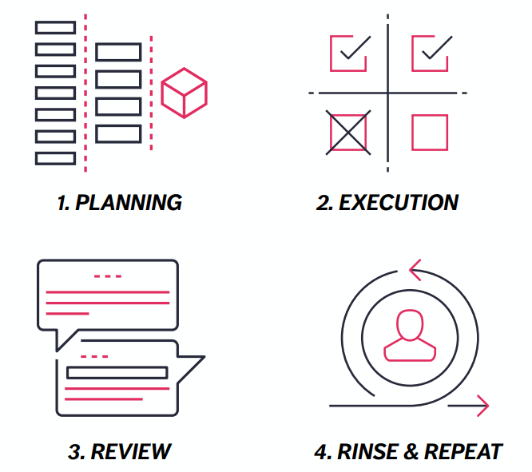
Agile Lifecycle

Slide 13
Various Agile Software development methodologies/flavours
Scrum: In Scrum, a list of all the deliverables for the project, named backlog, is identified and is continuously updated. Project is divided into small units named sprint, lasting 2-4 weeks generally. Deliverable, which is visible and usable increment, is decided for each sprint. Active communication in the team and follow-up using the backlog help and ease the development
eXtreme Programming: Works on the principle of Simplicity, Communication, Feedback and Courage. The application is designed such that it is adaptive to changing requirement and is simple. Lot of client interaction and communication in team are key factors which help in development of adaptive application.

Slide 14
Various Agile Software development methodologies/flavours
Agile Modeling: is used for modeling and documentation of software systems. It involves the software values, principle and practices which lead to software development in more flexible manner.
Adaptive Software Development (ASD): Works on the principle of continuous adaptation. It uses repeated series of speculate, collaborate and learn cycles to develop the application.
Crystal Clear and other Crystal methodologies: Crystal family of methodologies is people-centric and focuses on enhancing the work of people involved. The logic is to start with small tasks and then build them up into larger ones. The overhead activities are reduced and efforts are diverted to work building. It’s a collaborative process involving tracking and iterations.

Slide 15
Various Agile Software development methodologies/flavours
Lean software development: is based on lean manufacturing principle. The principles followed are:
Eliminate waste i.e. anything that does not add value to customer.
Amplify learning by doing and testing things rather than documenting them and implementing.
Decide as late as possible thus keeping all the possible the options open as long as possible in the life cycle.
Deliver as fast as possible. It works on basis of the fact that sooner the end product is delivered, sooner is the feedback received and sooner it is implemented in next iteration.
Empower the team by keeping people motivated.
Build integrity in by keeping the code simple and avoiding repetitions.
See the whole so the problems can dealt at application level, product level, instead of dealing with them at minute levels

Slide 16
KICKOFF/SPRINT PLANNING
Each scrum project begins with a kick-off meeting.
The first meeting is generally the most extensive as the initial project backlog needs to be created and the project team introduced.
Additionally, before each of the future sprints there is a sprint planning meeting.

Slide 17
The kick-off meeting’s goals are:
First, the kick-off meeting.
An overview of the project and the goals.
Who will be working on the project.
Determining the point person for client sign-off.
Creating the project backlog.
Determining which features to work on
Getting on the same page.

Slide 18
Project Backlog
Behind every project is a project backlog.
The project backlog is a list of all the product features generally defined by “user stories”.
User stories define everything potential users want to do on the site.
There are many tools to keep track of your project backlog, both analogue and digital options. The important thing is that the backlog is always accessible and easy to track

Slide 19
The sprint
Agile projects are broken down into small, consistent time intervals.
These intervals are referred to as sprints.
They can be as short as a few days and generally are no longer than 3 - 4 weeks.
During a sprint there is a dedicated team that includes designers, developers and business people working together.

Slide 20
The sprint
Before each sprint, there is a sprint planning meeting
This meeting determines what the goals are for that sprint.
During the sprint, no features are added and the sprint goals don’t change.

Slide 21
Daily standup
Every morning of the sprint the project team gets together for a short (under 15 minute) meeting.
This meeting takes place at the same time every day and includes everyone on the project.
Each person on the team is tasked to answer 3 simple questions:
What did you do yesterday?
What are you going to do today?
Do you need any help or are there any blockers in the way?
The results of this meeting are typically shared with the client.

Slide 22
Keys to success
Communication
Dedicated teams
Good planning

Slide 23
Resources
PIVOTAL TRACKER www.pivotaltracker.com The popular tracking tool that helps you manage your Agile projects. The feature set is robust, but the User Interface could be improved to make this a go-to tool.
TRELLO www.trello.com A simple online tool to help you manage the project backlog. Trill is like a set of digital post-it notes that you can easily rearrange.
ASANA www.asana.com Another popular management tool. Asana offers a more thorough feature set than Trello, but the interface is not as intuitive.

